Slide 1
The muscular and skeletal system or musculoskeletal system includes bones, muscles, tendons, ligaments and soft tissues
Benefits
Support your body's weight,
Maintain your posture
Help in the movement

Slide 2
  Bones:. The inner part of bones are softer and less dense than the hard outer part
  Protects internal organs, tissues, store calcium and fats. in addition it also produce blood cells.
  More than 200 bones in the body work with muscles, tendon and ligament for movements
  Cartilage: Acts as cushions for bones inside the joints along with spine and ribcage. It also protects bones from rubbing each other. Cartilages are present mainly in our nose, ears, and lungs

Slide 3
Three types of muscles in the body : 1. Skeletal muscles, Cardiac muscles and smooth muscles (in the blood vessels ,organs, digestive tract and skin )
What is skeletal muscle?
The majority of the muscles in the body are skeletal muscles. They make up between 30 to 40% of your total body mass.
Tendons (tough bands of connective tissue) attach skeletal muscle tissue to bones throughout your body.
Your shoulder muscles, hamstring muscles and abdominal muscles are all examples of skeletal muscles.

Slide 4
Muscles:
Skeletal muscle is the largest tissue in the body, accounting for almost 40% of body mass.
Skeletal muscle architecture is characterized by unique arrangement of muscle fibers, also called myofibers.
Groups of myofibers form the fascicles, and bundles of fascicles make up the whole muscle tissue .
Myofibers are formed by the fusion of myoblasts to produce myotubes

Slide 5
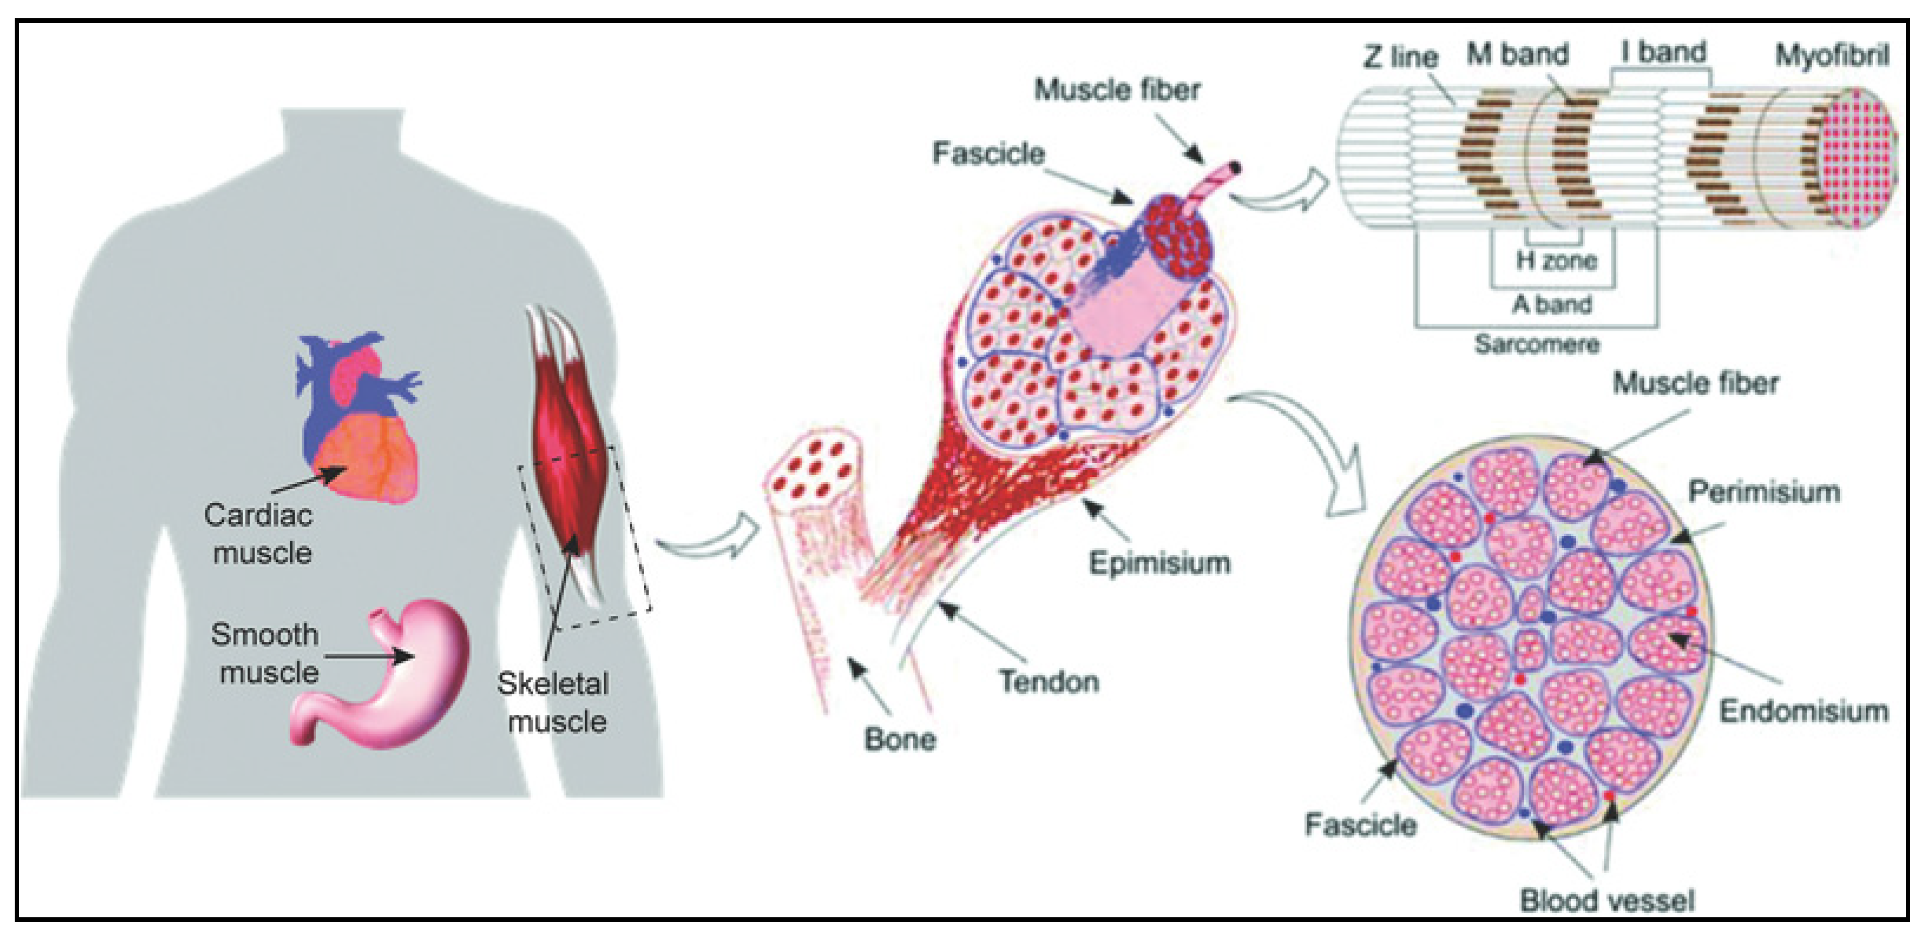


Slide 6
What is the purpose of the skeletal muscles?
The skeletal muscles are a vital part of your musculoskeletal system. They serve a variety of functions, including:
Chewing and swallowing, which are the first parts of digestion.
Expanding and contracting your chest cavity so you can inhale and exhale at will.
Maintaining body posture.
Moving the bones in different parts of your body.
Protecting joints and holding them in place.

Slide 7

Provides structure and movement for the body
Consists of bones, skeletal muscles, and joints
Allows the body to stand erect and move
Supports and protects organs
Produces red blood cells

Slide 8
Skeletal muscles consist of flexible muscle fibers that range from less than half an inch to just over three inches in diameter.
These fibers usually span the length of the muscle.
The fibers contract (tighten), which allows the muscles to move bones so you can perform lots of different movements.

Slide 9
Stores fat and minerals
Generates heat
Skeleton
Consists of 206 bones
Provides support for the soft tissue and organs of the body

Slide 10
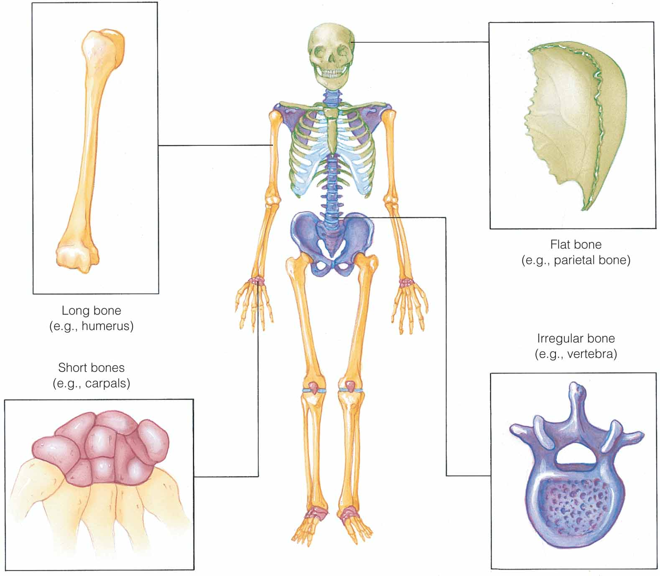

Slide 11

Major functions
  Framework for the body
  Protect structures
  Act as levers for movement
  Store fat and minerals
  Produce blood cells

Slide 12

Major functions
  Movement
  Posture
  Body heat
  Joints
Fibrous
Cartilaginous
Synovial

Slide 13

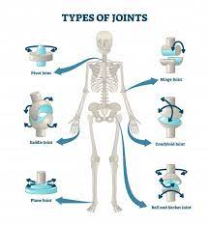
Ankle
Spine
shoulder joints

Slide 14

Flexion
Extension
Rotation
Circumduction
Elevation
Protrusion
Retraction
Abduction

Slide 15
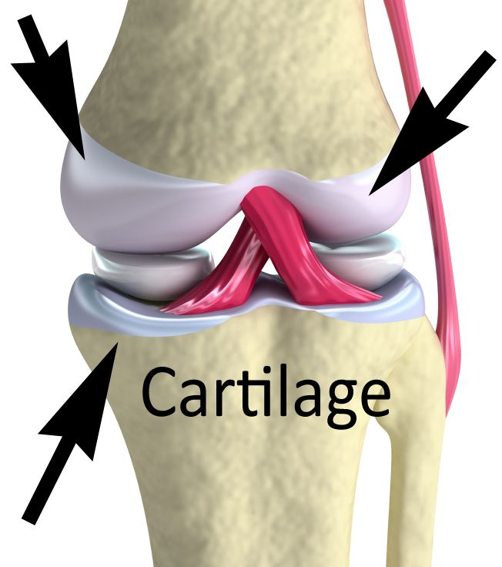

Slide 16
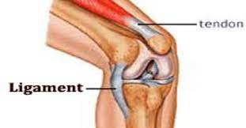
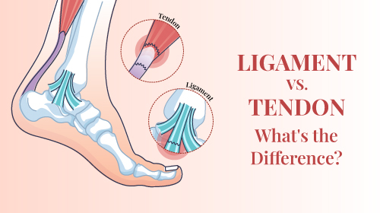
Ligaments: Made of tough fibers, ligaments connect bones and help stabilize joints.
Tendons: Tendons connect muscles to bones., tendons are tough but not very stretchy.

Slide 17
It works by controlling of our voluntary muscle movement by nervous system. voluntary muscles are the ones control intestinally.
Mechanism of musculoskeletal movements takes place when our nervous brain sends signal to sensitize the skeletal muscles.
Muscle fibres contract begins in response
The activated or sensitized muscle pulls on the tendon.

Slide 18
The tendon in turn attaches muscles to the bone.
Tendon pulls the bone and facilitates its movement
The brain sends another signal to relax the muscle and deactivate it.
Finally, the relaxed muscle releases tension, moving the bone to a resting position

Slide 19

1. Muscular dystrophy (MD)
What is muscular dystrophy?
MD is a group of muscle diseases caused by mutations ( changes in protein coding sequence of DNA) in a person DNA
Certain muscle protein is responsible for giving strength to muscle fibre.
When wrong protein is produced by the body due to mutation lead to muscle weakness.
Over the period of time, muscle weakness due to break down of skeletal muscle leading to increasing level of disability.

Slide 20
Lab grown cells for MD
Cell therapy technique can be used as engineering solution for DMD.
Some of the skeletal muscle cells can be grown in the laboratory and lab grown cells are delivered to the body through repeated injection at many point.
Hydrogels are convenient biomaterial for transfer of cells in to the body
Hydrogels acts as scaffolds that mimic or resemble the properties of the native muscle , play a crucial role in building skeletal muscle tissue constructs in lab.
Lab grown artificial skeletal muscle tissue is beneficial to replace dysfunctional skeletal muscle,

Slide 21
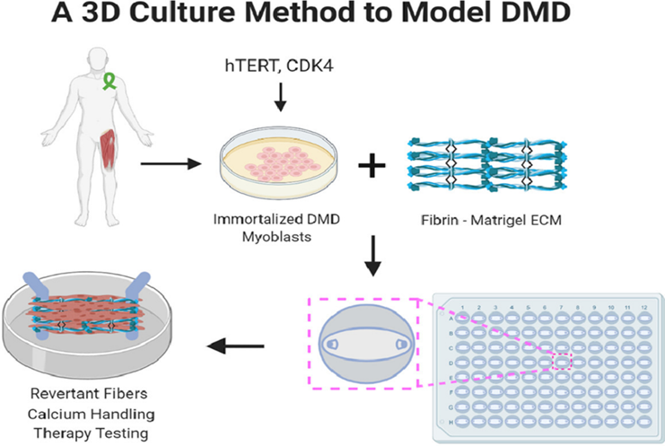

Slide 22
3D printing culture for Muscular Dystrophy problem
The most recent published approaches to culture myofibers on aligned structures can be classified into three main types: micropatterning, electrospinning, and bioprinting.
The simplest models for generating skeletal muscle in vitro are based on the 2D and 3D culture of myoblasts seeded on micromolded substrates.
Electrospinning technique has been successfully used to generate mature myotubes over microfibres fibrin bundles
Wearable robotic exoskeletons (WREs) can serve as means to accomplish the goal.

Slide 23
Engineering solution for Osteoporosis
Osteoporosis is an age-related bone disease characterized by low bone mineral density and bone degradation, leading to an increased risk of fractures
Biomimetic materials are designed and manufactured, and they create suitable conditions for restoration to promote tissue repair.
3D printing bone cell culture
3D printing is a manufacturing technology that deposits layers of medical biological materials and creates 3D objects based on a digital model of the patient’s internal (anatomical) structure.

Slide 24
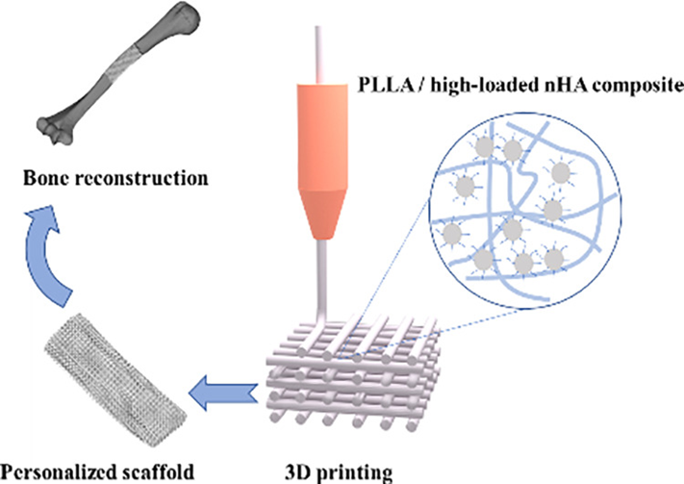
3D printing play a key role in orthopedic internal fixation surgery in the placement of pedicle screws during surgery
Scaffolds imitating 3D porous structures similar to native bone have been manufactured using 3D printing technology

